Slide 1

Data Analysis Internship Project
Cognifyz Technologies
BY: TARUN KUMAR

Slide 2
OVERVIEW
GOAL : Analyse a restaurant dataset to discover the hidden trends and patterns within it.
TOOLS : MySQL, Microsoft power BI.
Levels completed : Level 1, Level 2.

Slide 3
LEVEL-1

Slide 4
TASK-1
Top Cuisines Analysis - Summary
The main goal of this analysis was to identify the most popular cuisines in the dataset. We discovered two key findings:
Most Common Cuisines: According to our analysis, North Indian is the most common cuisine with approximately 2,500 outlets. This is followed by Chinese (1,600 outlets) and Fast Food (800 outlets).
Market Share: When we looked at the percentage share, we found that North Indian cuisine alone covers over 17% of the market. Combined, these top three cuisines (North Indian, Chinese, and Fast Food) account for nearly 33% of all restaurants in the dataset.
Key Insight: This clearly shows the market dominance of North Indian and Chinese food, which is a crucial piece of business intelligence.

Slide 5
TASK-2
City Analysis - Summary
The objective of this task was to analyze the geographical distribution of restaurants and identify top-performing cities based on two key metrics: the total number of restaurants and their average customer ratings.
Top City by Restaurant Count: The analysis reveals that Vizag is the leading city in terms of restaurant density, hosting the highest number of outlets (53) in the dataset.
Top City by Average Rating: However, when evaluating customer satisfaction, Vineland Station stands out as the top performer with an impressive average rating of 4.30.
Key Insight: This analysis highlights a crucial business insight: the city with the most restaurants is not necessarily the city with the best-rated ones. This distinguishes between market presence (quantity) and customer satisfaction (quality).

Slide 6
TASK-3
Price Range Distribution - Summary
This task aimed to analyze the market positioning of restaurants based on their price points. The analysis provides a clear picture of the restaurant industry's cost structure.
Market Concentration: The data reveals that the market is predominantly concentrated in the lower to mid-tier price ranges. Price Range 1 (the most budget-friendly option) is the largest single category, containing over 5,700 restaurants.
Affordable Dining Dominance: When combined, Price Range 1 and 2 represent the vast majority of the establishments. This indicates that the industry heavily caters to budget-conscious and mid-range consumers.
Key Insight: There is a significantly smaller market for premium and luxury dining experiences, as Price Range 4 is the least common category. This suggests that the greatest competition and customer base exist within the more affordable segments of the restaurant market.

Slide 7
TASK-4
Online Delivery Analysis - Summary
This analysis focused on the adoption of online delivery services among restaurants and its potential impact on customer ratings. The findings reveal a clear and important trend.
Adoption Rate: The data shows that a majority of restaurants (73.38%) in the dataset do not currently offer online delivery. Only a smaller portion (26.62%) has adopted this service, indicating there is still significant room for growth in this area.
Impact on Customer Ratings: A strong correlation exists between online delivery and higher customer satisfaction. Restaurants that provide an online delivery option have a substantially higher average rating (3.4) compared to those that do not (2.7).
Key Insight: Offering online delivery is a key differentiator that is strongly associated with better customer reviews. This suggests that convenience is a critical factor for modern customers, and restaurants embracing this service are perceived more favorably.

Slide 8
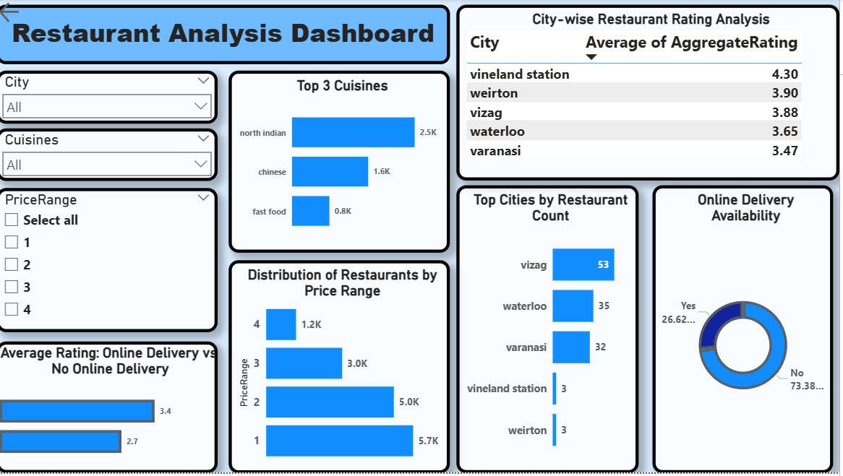
LEVEL 1: DASHBOARD

Slide 9
LEVEL 1: KEY FINDINGS
This dashboard provides a comprehensive overview of the restaurant market, revealing several critical insights for business strategy.
Market Landscape is Dominated by Affordability and Popular Cuisines: The analysis clearly shows that North Indian and Chinese are the top cuisines, commanding a significant market share. The majority of restaurants operate in the lower price ranges (Price Range 1 & 2), indicating the market is heavily skewed towards budget-friendly dining.
Geographic Disparity Between Quantity and Quality: While cities like Vizag have the highest concentration of restaurants, smaller locations such as Vineland Station lead with the highest average customer ratings. This highlights that market presence does not always equate to higher customer satisfaction.
Online Delivery is a Powerful Driver of High Ratings: A key finding is the strong correlation between service offerings and customer perception. Although only a minority of restaurants (~27%) offer online delivery, they achieve a significantly higher average rating (3.4) compared to those without (2.7).
Overall Insight: The data suggests that the most successful restaurant profile in this market is an affordable establishment, likely serving North Indian or Chinese food, that has embraced the convenience of online delivery to boost customer satisfaction.

Slide 10
LEVEL-2

Slide 11
TASK-1
Restaurant Ratings Analysis - Summary
This task focused on understanding the landscape of customer satisfaction by analyzing the distribution of aggregate ratings and the average number of votes restaurants receive.
Rating Distribution: The analysis reveals a distinct trend in customer ratings. The majority of restaurants are concentrated in the 3.0 to 4.0 rating range, with the most common rating being 3.0, which accounts for nearly 1,900 establishments. This suggests that while few restaurants are poorly rated, truly exceptional ratings (above 4.5) are also uncommon.
Average Customer Engagement: On average, a restaurant in this dataset receives 158 votes. This metric serves as a baseline for understanding the typical level of customer engagement and feedback.
Key Insight: The market is largely composed of "good" to "very good" restaurants, with a clear clustering around the average rating. This indicates a competitive market where achieving a high rating requires exceptional service, as the average restaurant garners a moderate number of votes.

Slide 12
TASK-2
Cuisine Combination Analysis - Summary
This analysis aimed to identify which combinations of cuisines are most common and which combinations tend to receive the highest customer ratings.
High Ratings in Niche Combinations: The analysis shows that many unique and specific cuisine combinations achieve exceptionally high ratings, such as "American, BBQ, Sandwich" and "Italian, Bakery, Continental", both scoring an average of 4.90. This suggests that restaurants offering specialized or fusion menus are often highly regarded by customers.
Popularity vs. Rarity: While these niche combinations have near-perfect ratings, they are often found in only a single restaurant. This indicates that high ratings are more easily achieved by unique establishments. In contrast, more common combinations might have a wider range of ratings due to a larger number of outlets.
Key Insight: There is a significant opportunity for restaurants offering unique or well-executed fusion menus to achieve top-tier customer ratings. While a combination might be rare, its quality can lead to exceptional customer satisfaction.

Slide 13
TASK-3
Geographical Analysis - Summary
This task involved plotting restaurant locations on an interactive map to visualize their distribution and identify geographical patterns.
Concentration in Urban Centers: The map clearly illustrates that restaurants are densely concentrated in major metropolitan areas, particularly in and around large cities like New Delhi. This creates distinct "food hubs" where competition is high and variety is abundant.
Interactive Exploration: The map is enhanced with interactive slicers, allowing for dynamic analysis. Users can filter the view by City to focus on a specific urban area or by Cuisines to track the geographical footprint of a particular food type. For instance, selecting "New Delhi" instantly zooms in to show the distribution of restaurants within that specific region.
Key Insight: Geographical data is crucial for understanding market saturation and identifying potential locations for new restaurants. This interactive map serves as a powerful tool for strategic decision-making, allowing stakeholders to explore regional tastes and competition levels visually.

Slide 14
TASK-4
Restaurant Chain Analysis - Summary
This task involved identifying restaurant chains by cleaning and analyzing restaurant names. The goal was to compare their market presence, customer ratings, and popularity.
Data Cleaning was Crucial: Identifying chains was only possible after significant data cleaning in Power Query. Steps like trimming, converting to lowercase, and splitting by delimiters were essential to group different outlets of the same chain (e.g., 'Daawat' and ‘daawat') together accurately.
Performance Metrics: The analysis provided key performance indicators for each chain, including the total number of outlets, their average aggregate rating, and the total sum of votes. This allows for a direct comparison of brand strength and customer satisfaction.
Key Insight: Simply having a large number of outlets does not guarantee high ratings or popularity. For example, some chains like 'Chor Bizarre' and 'Coffee Culture' have few outlets but achieve high average ratings (4.15), indicating strong brand quality. This analysis is vital for competitive benchmarking.

Slide 15
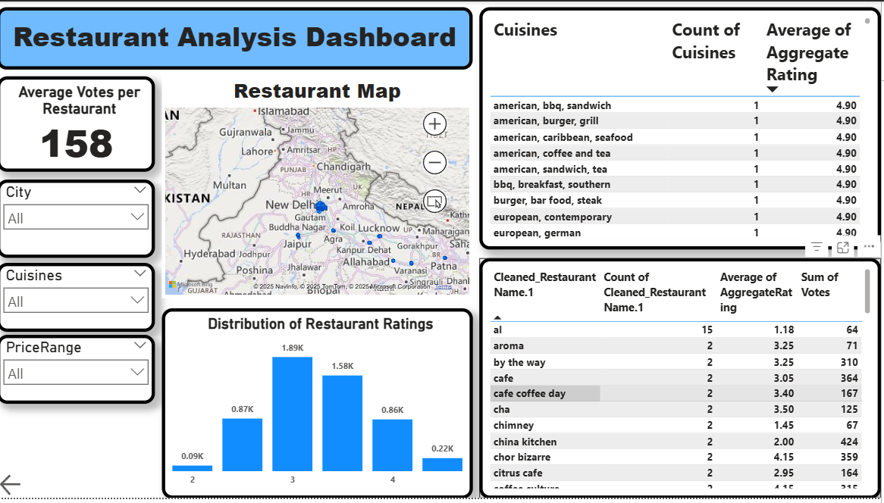
LEVEL 2: DASHBOARD

Slide 16
LEVEL 2: KEY FINDINGS
This fully interactive dashboard integrates the advanced analyses from Level 2 to provide a multi-dimensional view of the restaurant market, focusing on performance, specialization, and brand presence.
Market Performance Standard: The analysis establishes a clear benchmark for an average restaurant. The most common rating is 3.0, and the average establishment garners 158 customer votes. This indicates a highly competitive market where achieving standout performance is a significant challenge.
Specialization Drives Excellence: A key insight is that niche and specialized restaurants often outperform common ones in customer satisfaction. Unique cuisine combinations frequently achieve the highest possible ratings (4.90), and smaller, quality-focused restaurant chains like 'Chor Bizarre' (4.15 rating) are rated higher than many larger competitors.
Strategic and Interactive Tool: The dashboard serves as a powerful strategic tool. The interactive map and slicers for City, Cuisine, and Price Range allow for deep-dive analysis. Stakeholders can instantly visualize geographic food hubs, assess the performance of specific cuisines, or analyze the competitive landscape within a particular city.
Overall Insight: The Level 2 analysis proves that success in the restaurant industry is not just about scale, but about quality and specialization. The most highly-rated establishments are often those that offer a unique menu or maintain a high standard of quality across a smaller chain of outlets.

Slide 17
INTERACTIVE DASHBOARD DEMO
SLICERS: Provided the ability to live-filter data by City, PriceRange and Cuisines.
CROSS-FILTERING: Clicking on one chart dynamically updates the entire report.
NAVIGATION: Easy navigation to any analysis page using buttons.

Slide 18
LEARNINGS & ACHIEVEMENTS
DATA CLEANING: Cleaned real-world messy data(like restaurant names) using Power Query.
DAX & VISUALIZATION: Created effective charts and tables using simple and complex calculations.
DASHBOARDING: Combined different analysis to build a complete interconnected data story.
PROBLEM SOLVING: Effectively solved real-world data challenges encountered at every step.

Slide 19
Thank You!!!
Thank you to Cognifyz Technologies for this excellent opportunity.
Tarun kumar

